Slide 1
Descriptive Statistics with Python solutions

Slide 2
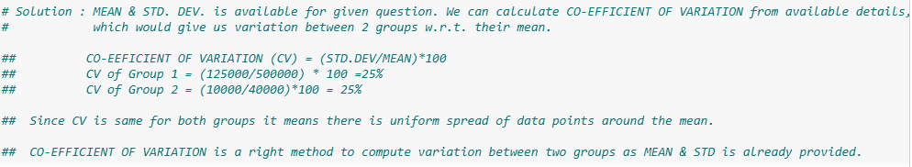
# 1. A statistics test was conducted for 10 learners in a class. The mean of their score is 85 and the variance of the score is zero. What can you interpret about the score obtained by all learners?
# 2. In a residential locality, the mean size of the house is 2224 square feet and the median value of the house is 1500 square feet. What can you interpret about the skewness in the distribution of house size? Are there more bigger or smaller houses in the residential locality?
# 3. The following table shows the mean and variance of the expenditure for two groups of people. You want to compare the variability in expenditure for both groups with respect to their mean. Which statistical measure would you use to evaluate the variability in expenditure? Please provide an explanation for your answer.

Slide 3
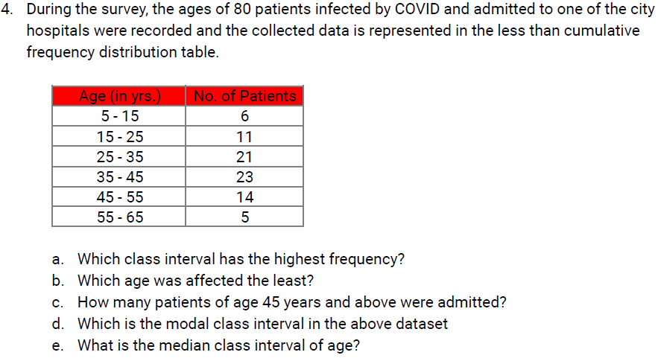
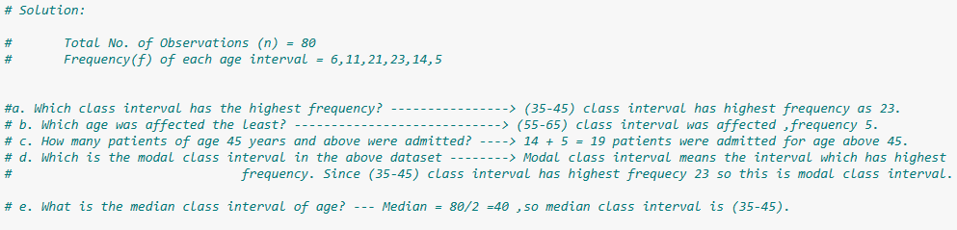

Slide 4
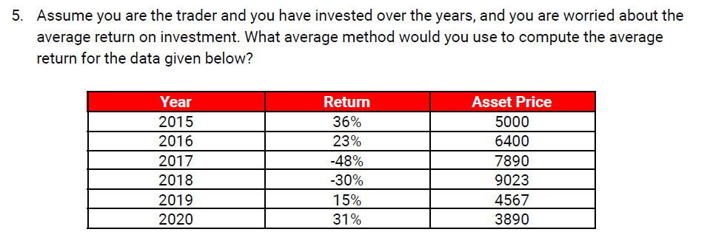

Slide 5
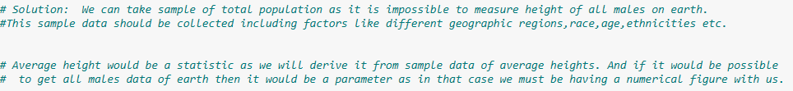

Slide 6
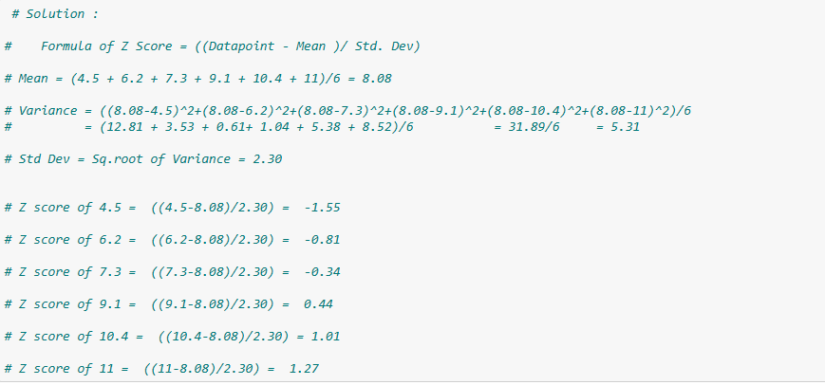
# 7. Calculate the z score of the following numbers: X = [4.5,6.2,7.3,9.1,10.4,11]

Slide 7
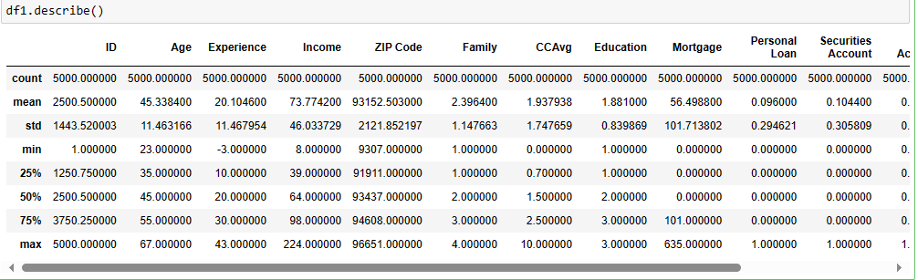
# 8. Give us the statistical summary for all the variables in the dataset.

Slide 8
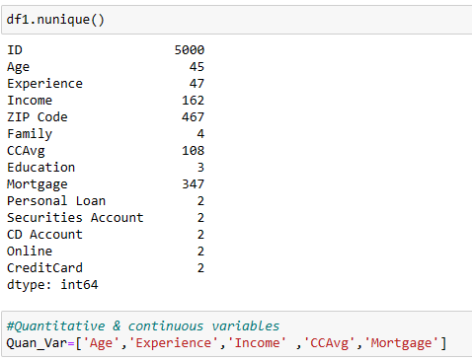
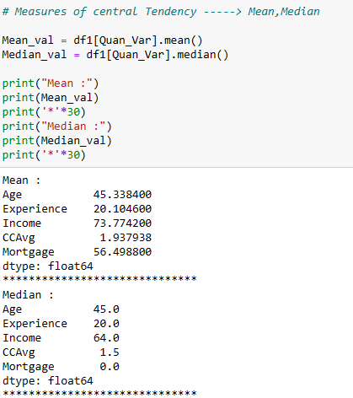
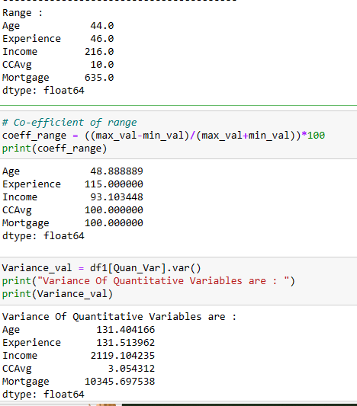
#9. Evaluate the measures of central tendency and measures of dispersion for all the quantitative variables in the dataset.

Slide 9
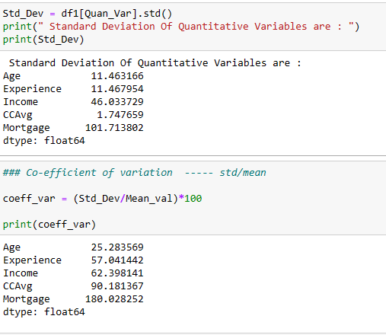

Slide 10
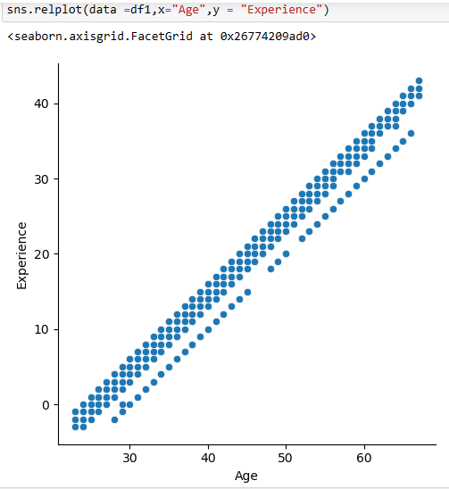
# 10. What statistical method will you use to examine the presence of a linear relationship between age and experience variables? Also, create a Plot to illustrate this relationship.

Slide 11
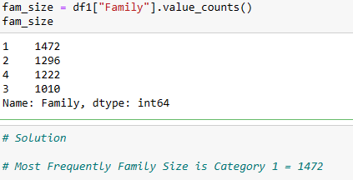
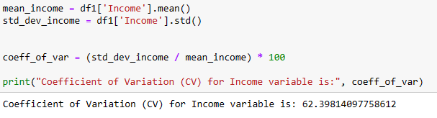
# 11. What is the most frequent family size observed in this dataset?
# 12. What is the percentage of variation you can observe in the ‘Income’ variable?

Slide 12
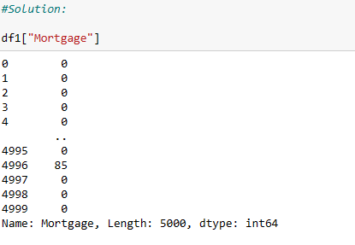
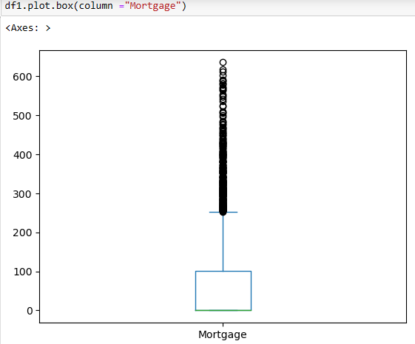
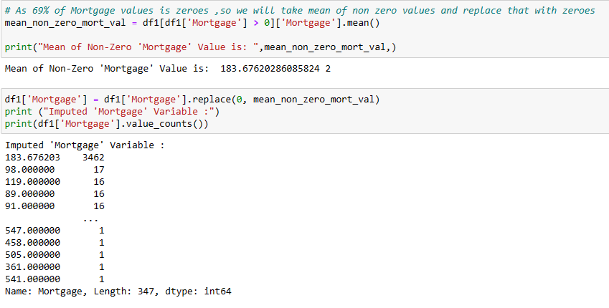
# 13. The ‘Mortgage’ variable has a lot of zeroes. Impute with some business logical value that you feel fit for the data.

Slide 13
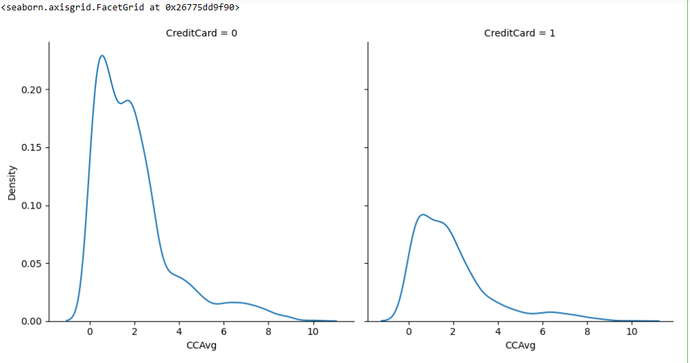
# 14 : Plot a density curve of the ‘CCAvg’ variable for the customers who possess credit cards and write an interpretation about its distribution.

Slide 14
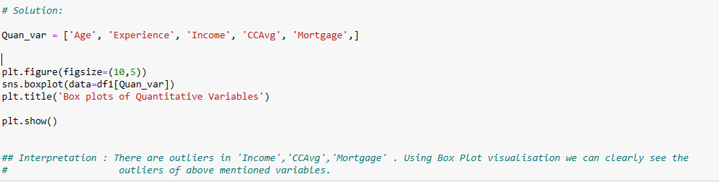
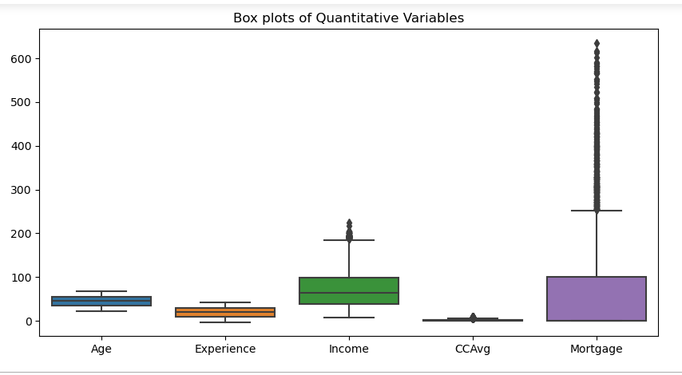
# 15.Do you see any outliers in the dataset? If yes, what plot you would think will be suitable to showcase to the stakeholders?

Slide 15
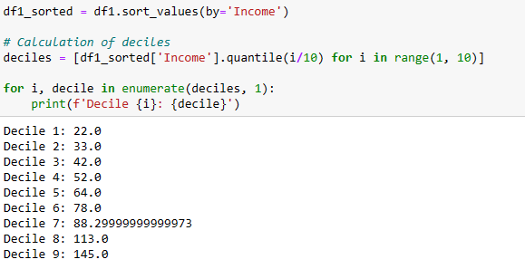
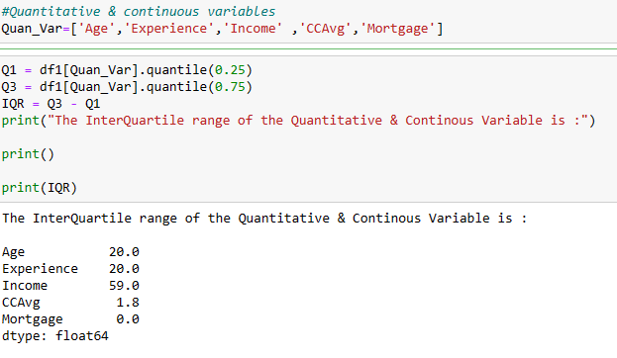
#16: Give us the decile values of the variable ‘Income’ in the dataset.
# 17 :Give the IQR of all the variables which are quantitative and continuous.

Slide 16

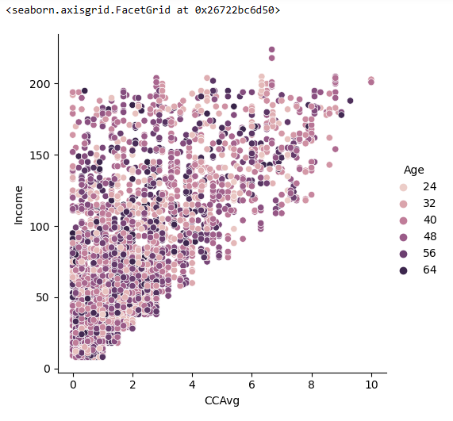
# 18. Do the higher-income holders spend more on credit cards?

Slide 17
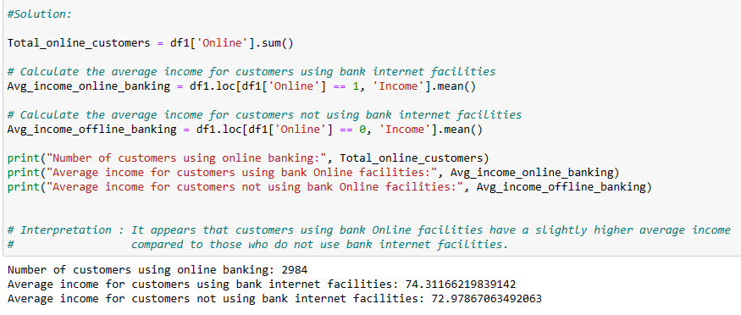
# 19 : How many customers use online banking? Do customers using bank internet facilities have higher income?

Slide 18
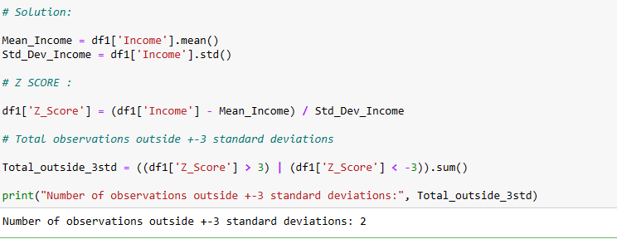
# 20. Using the z-score of the income variable, find out the number of observations outside the +-3 STD DEV.

Slide 19
Thank you
MUKKTI S BHUYAN
ABADS BATCH 11

